Slide 1
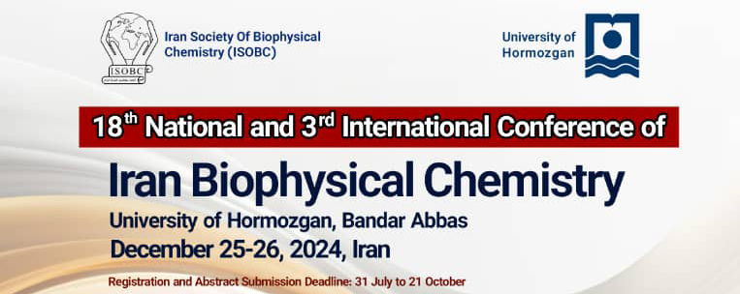
Title 46 pt in bold font Times New Roman
First author , second author,… (crosdpondung author is specified by *, font Times New Roman 46 pt)
Abstract
Method
The text of all sections of the poster, except for the references (Times New Roman 26), should be formatted in a right-aligned paragraph style (right to left) with justification. Avoid vague statements and clearly present the main points and objectives of the paper, summarizing all sections concisely. Please note that the poster size is 60 by 90 centimeters, and authors are requested to adhere to the poster template. The font for the title of the paper, authors, their details, and the email of the corresponding author should conform to the above template.
In this section, explain the necessity of conducting your research and clearly outline the research objectives, avoiding unnecessary details and generalities.
Efforts should be made to avoid mentioning all details, and the main methods of the work should be explained concisely and clearly. It is not necessary to provide exhaustive information about all aspects of the methodology and tools used, including models, software, etc.
Result
More diagrams and tables should be used, which should be clearly and effectively organized. The font should not be smaller than that of the introduction. If your paper is a review, only include the conclusion in the relevant section.
Conclusion
Main References
The use of more diagrams and tables is encouraged, which should be clearly and effectively organized.
In this section, efforts should be made to use important and primary sources, with sources numbered in order from Persian to English. Use font Times New Roman in size 16 for English sources.
Additionally, you can include acknowledgments in this section. At your discretion, you can adjust the length of sections based on the volume of content.
These guidelines will help you organize the references section in a clear and readable manner.

